Slide 1


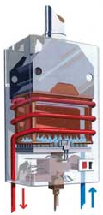
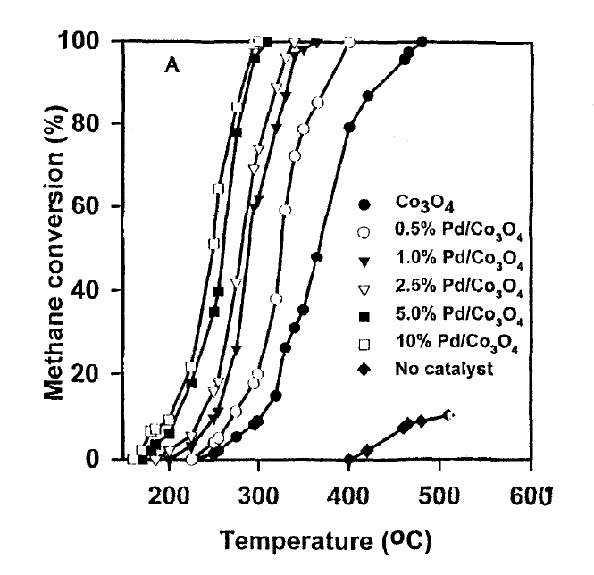


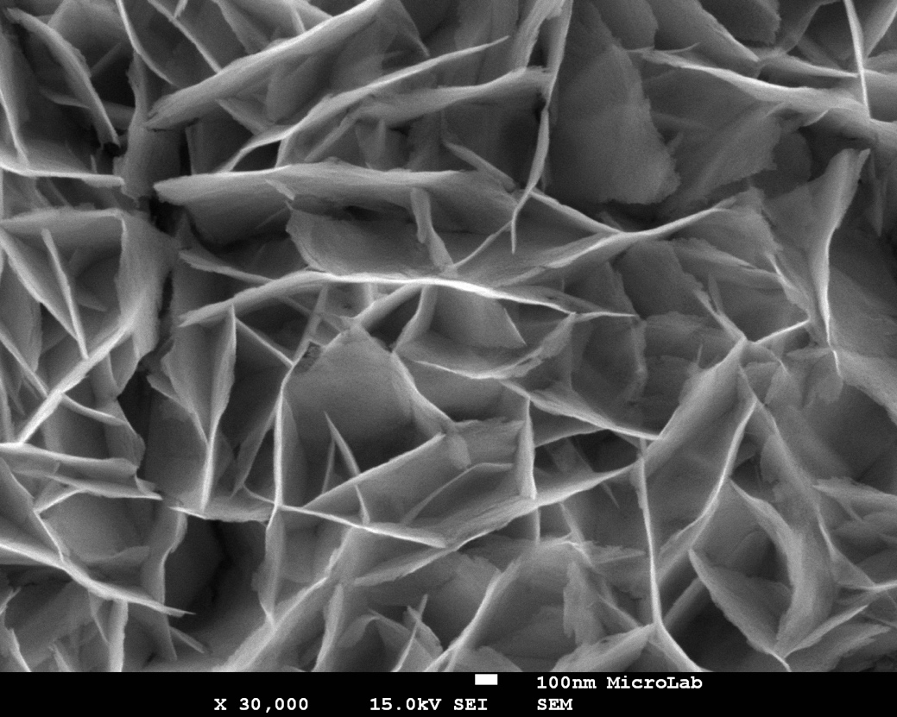
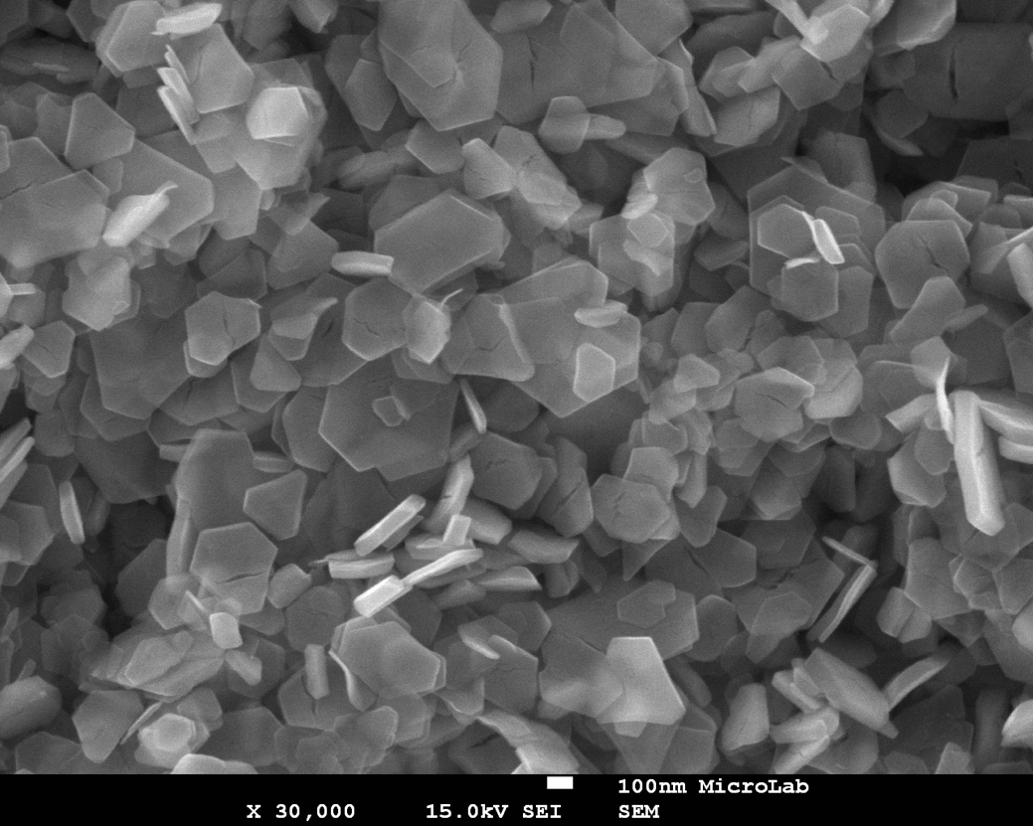
NOVEL DESIGN OF A CATALYTIC HEAT EXCHANGER FOR RESIDENTIAL AND INDUSTRIAL WATER HEATING
José Rodrigues, Edgar Fernandes
IN+ / IST / LARSyS
ABSTRACT
The Catalytic Heat Exchanger is a heat exchanger wall-coated with a catalytic layer, in which hydrocarbons react and release heat. That heat is absorbed by the fluid inside the heat exchanger. This concept can be used to heat water and other fluids and is suitable for domestic and industrial applications.
X
X
Combustion products are solely H₂O and CO₂, with near-zero emission of CO and NOx due to complete combustion at low temperatures (btw. 600°C and 1000°C)
NO_{X}
CO
Smaller,
Simpler,
Quieter
Traditional concept
Novel
concept
Cobalt oxide (Co₃O₄) electrodeposition deposited on a stainless-stell plate resulted on a very high specific area, with high potential for good catalytic activity.
With a flameless reaction, designers can eliminate the large volume required for the combustor chamber. Also, catalytic combustion on the walls of the heat exchanger integrates the combustor and the heat exchanger on a single module, instead of the typical 2. These features will allow smaller designs, as well as less operation noise.
NATURAL
GAS
Catalytic combustors are more fuel flexible than traditional combustors due to the low dependence on the velocity fields, flame speed and mixture quality. The reaction is flameless and stability depends on heat fluxes on the reacting surface.
It is possible to replace Platinum and Palladium as catalyst for the methane combustion reaction. Cobalt oxide and others have proven to be good candidates, with low loss of performance, inexpensive and easy to obtain.
REFERENCES
[1] Lee JH, Trimm DL. Catalytic Combustion of Methane. Fuel Process Technol 1995;42:339–59.
[2] Li Z, Hoflund GB. CATALYTIC OXIDATION OF METHANE OVER Pd/Co304. React Kinet Catal Lett 1999;66:367–74.
[3] Specchia S, Toniato G. Natural gas combustion catalysts for environmental-friendly domestic burners. Catal Today 2009;147:S99–106.
[4] Xu M, He X, Azevedo JLT, Carvalho MG. Combustion of methane in catalytic honeycomb monolith burners. Int J Energy Res 2000;24:1181–201.
The total loading of the electro-deposition process affects the nanostructures of cobalt on the surface. Higher loads result on hexagonal cobalt nano-cristals while a lower load produces on long cobalt blades, both structures with high specific surface area. The distinct nano-structures may have influence on the catalyst activity and on its durability, yet to be investigated.
Low load
High load

